Slide 1
Pandas Ref: https://pandas.pydata.org/
Disha Parkhi

Slide 2
Introduction
Pandas is a library built using NumPy specifically for data analysis
Pandas can be used for data manipulation, visualisation, building machine learning models, etc
There are two main data structures in Pandas - Series and Dataframes
The default way to store data is dataframes, and thus manipulating dataframes quickly is probably the most important skill set for data analysis

Slide 3
Pandas Series
A series is similar to a 1-D numpy array, and contains scalar values of the same type (numeric, character, datetime etc.)
Series is built on top of NumPy array object
But series cannot be accessed by labels
Series are one-dimensional array-like structures, though unlike NumPy arrays, they often contain non-numeric data (characters, dates, time, booleans etc.)
You can create pandas series from array-like objects using pd.Series()

Slide 4
Pandas Dataframes
Dataframe is the most widely used data-structure in data analysis
It is a table with rows and columns, with rows having an index and columns having meaningful names
There are various ways of creating dataframes, such as creating them from dictionaries, JSON objects, reading from txt, CSV files, etc.
A dataframe is simply a table where each column is a pandas series

Slide 5
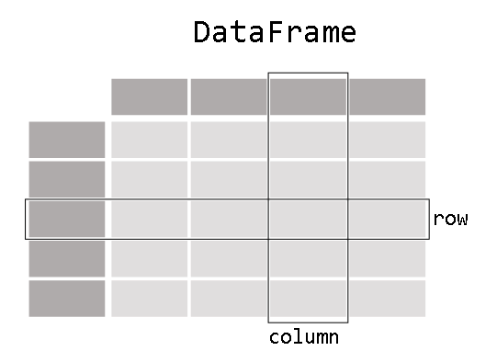
Dataframe

Slide 6
Indexing and Selecting Data Selecting Rows/Columns
Selecting rows in dataframes is similar to the indexing you have seen in NumPy arrays
The syntax df[start_index:end_index]will subset rows according to the start and end indices
We can grab columns from a dataframe, like, df[[‘Colum1],[‘Column2’]]
We can add a column/row or delete a column/row from a dataframe

Slide 7
Indexing dataframes:
Position based indexing using df.iloc
Label based indexing using df.loc
Using both the methods, we will do the following indexing operations on a dataframe:
Selecting single elements/cells
Selecting single and multiple rows
Selecting single and multiple columns
Selecting multiple rows and columns

Slide 8
Groupby Method on Dataframes
The groupby method allows you to group rows of data together and call aggregate functions

Slide 9
Missing Data
There can some missing data in dataframe
Usually we see ‘NaN’ at missing data cells
We can remove those rows/columns where data is missing (by df.dropna() or df.dropna(axis=1) functions)
We can fill a specific value to the missing value cells (by function fillna())

Slide 10
Merging, Joining and concatenating data frames
Pd.concat([‘df1’,’df2’,’df3’]): three data frames are concatenated one below the other
Pd.concat([‘df1’,’df2’,’df3’],axis= 1): three data frames are concatenated column wise
Pd.merge() will merge the data frames
Pd.join() will join the data frames based on indexes

Slide 11
Pandas operations
df[‘column’].unique()
will display array of unique values from that column
df[‘column’].nunique()
will display number of unique values from that column
df[‘column’].value_count()
will display count of each unique value from that column

Slide 12
We can apply functions to the data frames
eg: df[‘col1’].sum: will give sum of all the values
See notebook:

